Slide 1
INTERNET OF THINGS (20MCA281)
Prepared By: Ms. Joice T
Starts on : Aug 10 2022

Slide 2
Course Outcome
After completion of the course the student will be able to
Describe the main concepts and features of the IOT paradigm.(CO1)
Discuss Fog computing, TinyOS - nesC and programming frameworks for IOT (CO2)
Describe the data management techniques applied to the IOT environment. (CO3)
Explain security, and privacy in IOT environments (CO4)
Discuss key enablers and solutions to enable practical IoT systems(CO5)

Slide 3
Course Level Assessment Questions on Course Outcome 1
Compare SOA-based architecture and API-oriented architecture.
Neatly sketch the open IOT architecture for IOT/CLOUD convergence.
List and explain the applications of device/cloud collaboration.

Slide 4
HISTORY OF INTERNET OF THINGS
1982- Concept of network of smart devices
  Modified coco-cola vending machine
  At Carnegie Mellon University first internet connected appliance
  It was able to report its inventory
  To check whether newly loaded drinks were cold or hot
1994 – Reza Raji – concept in IEEE Spectrum
  Moving small packets of data to a large set of nodes
  Integrate and automate everything from home appliances to factory
Between 1993 and 1997 several companies proposed solutions like Microsoft at Work or Novell’s NEST
1999 - Bill joy envisioned device to device communication as part of his “Six Webs” framework at the World Economic Forum

Slide 5
HISTORY OF INTERNET OF THINGS
1999 “Internet of Things” coined by Kevin Ashton
Kevin Ashton is accredited for using the term “Internet of Things” for the first time during a presentation in 1999 on supply-chain management
New IoT definitions give more value to the need for ubiquitous and autonomous networks of objects where identification and service integration have an important and inevitable role. For example, Internet of Everything (IoE) is used by Cisco to refer to people, things, and places that can expose their services to other entities

Slide 6
INTERNET OF THINGS: AN OVERVIEW
Definition
IoT is a system of interrelated computing devices, mechanical and digital machines, objects, animals or people provided with unique identifiers(UID) and the ability to transfer data over a network without requiring human to human or human to computer interaction.
The Internet of Things (IoT) sensor network is a network of billions of smart devices that connect people, system and other applications to collect and share data. It is a relationship between people to people, people-thing, thing-thing

Slide 7
INTERNET OF THINGS: AN OVERVIEW
Two important pillars of IoT: “Internet” and “Things”
Every object capable of connecting to the Internet will fall into the “Things” category
A person with a heart monitor implant, an automobile with sensor to alert the driver etc are some examples of things
Generic set of entities(things), including smart devices, sensors, human beings, and any other object that is aware of its context and is able to communicate with other entities, making it accessible at any time, any where.

Slide 8
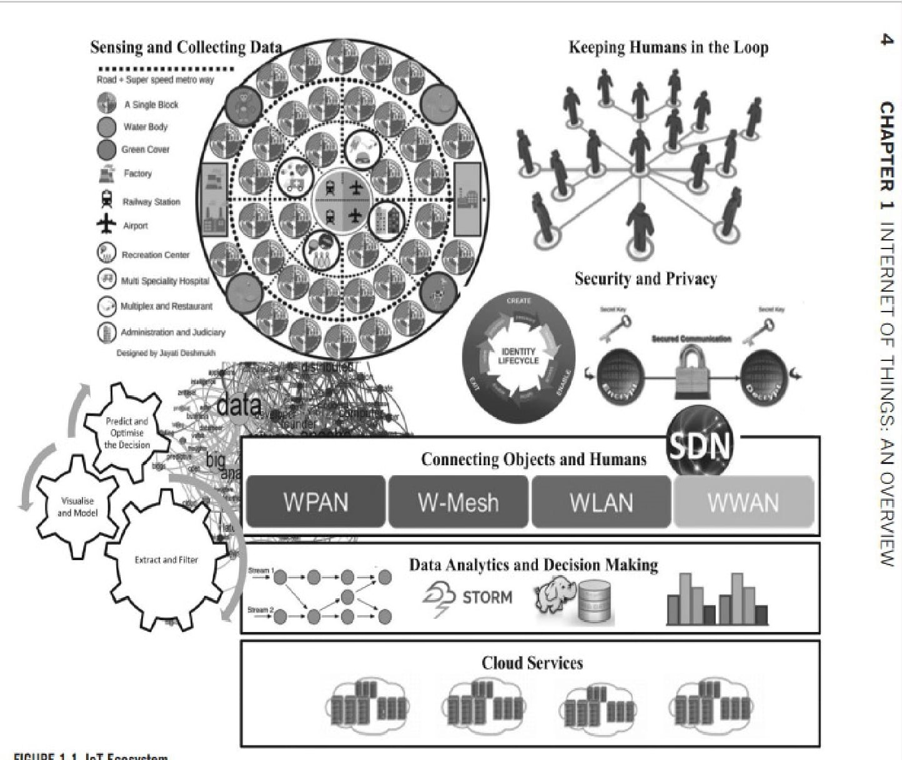
INTERNET OF THINGS: ECO SYSTEM(pg.29)

Slide 9
INTERNET OF THINGS: ECO SYSTEM
IoT is not a single technology; rather it is an agglomeration of various technologies that work together in tandem
Sensors and actuators are devices, which help in interacting with the physical environment.
The data collected by the sensors has to be stored and processed intelligently in order to derive useful inferences from it.
An actuator is a device that is used to effect a change in the environment such as the temperature controller of an air conditioner.
The storage and processing of data can be done on the edge of the network itself or in a remote server.
IoT finds various applications in health care, education, entertainment, environment monitoring, home automation, and transport systems.

Slide 10
INTERNET OF THINGS: ECO SYSTEM
The Main Components of Eco Systems:
Sensors for Collection the data
Extract and filter data from the collected bigdata
Data analytics and decision making
Predict and optimize the decision
Visualize the model
Keeping human in the loop
Security and privacy measures
Connecting objects and humans
Cloud services

Slide 11
INTERNET OF THINGS DEFINITION EVOLUTION
IoT EMERGENCE
Kevin Ashton is accredited for using the term “Internet of Things” for the first time during a presentation in 1999 on supply-chain management

Slide 12
INTERNET OF THINGS DEFINITION EVOLUTION
INTERNET OF EVERYTHING (IoE)
IoT mainly focus on connectivity and sensory requirements for entities
IoE focus on people, things, and places that can expose their services to other entities
The Internet of Everything (IoE) is a concept that extends the Internet of Things (IoT) emphasis on machine-to-machine (M2M) communications to describe a more complex system that also encompasses people and processes. Ubiquitous connectivity is a crucial requirement of IoE

Slide 13
INTERNET OF THINGS DEFINITION EVOLUTION
INDUSTRIAL IoT
Machine to Machine Communication, BigData Analytics and Machine Learning techniques are major building blocks of
IIoT
HUMAN IN THE LOOP
Human in the loop(Human-in-the-loop (HITL) is a branch of artificial intelligence that leverages both human and machine intelligence using ML) of IoT offers numerous advantages to a wide range of applications, including emergency management, healthcare
Another essential role of IoT is to build a collaborative system that is capable of effectively responding to an event captured via sensors
These improves the quality of life

Slide 14
INTERNET OF THINGS DEFINITION EVOLUTION
SMARTNESS IN IoT
Another characteristic of IoT, which is highlighted in recent definitions, is “smartness.” This distinguishes IoT from similar concepts such as sensor networks, and it can be further categorized into “object smartness” and “network smartness.”

Slide 15
INTERNET OF THINGS DEFINITION EVOLUTION
MARKET SHARE
In addition, definitions draw special attention to the potential market of IoT with a fast growing rate, by having a market value of $44.0 billion in 2011

Slide 16
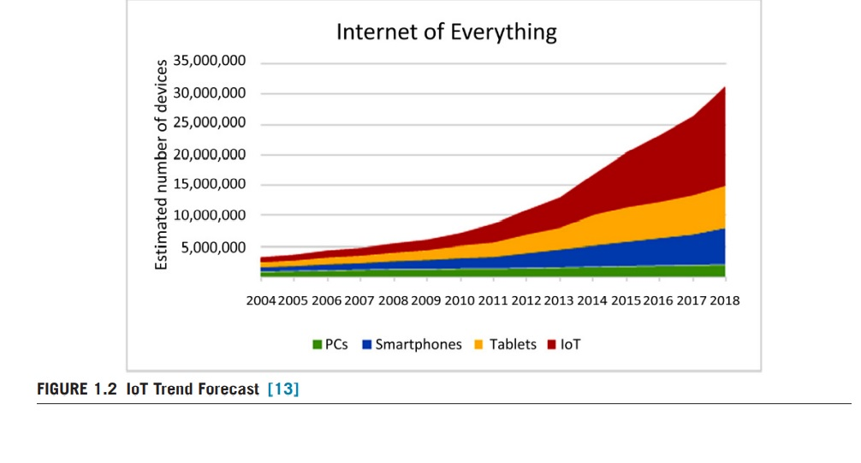
INTERNET OF THINGS DEFINITION EVOLUTION
MARKET SHARE

Slide 17
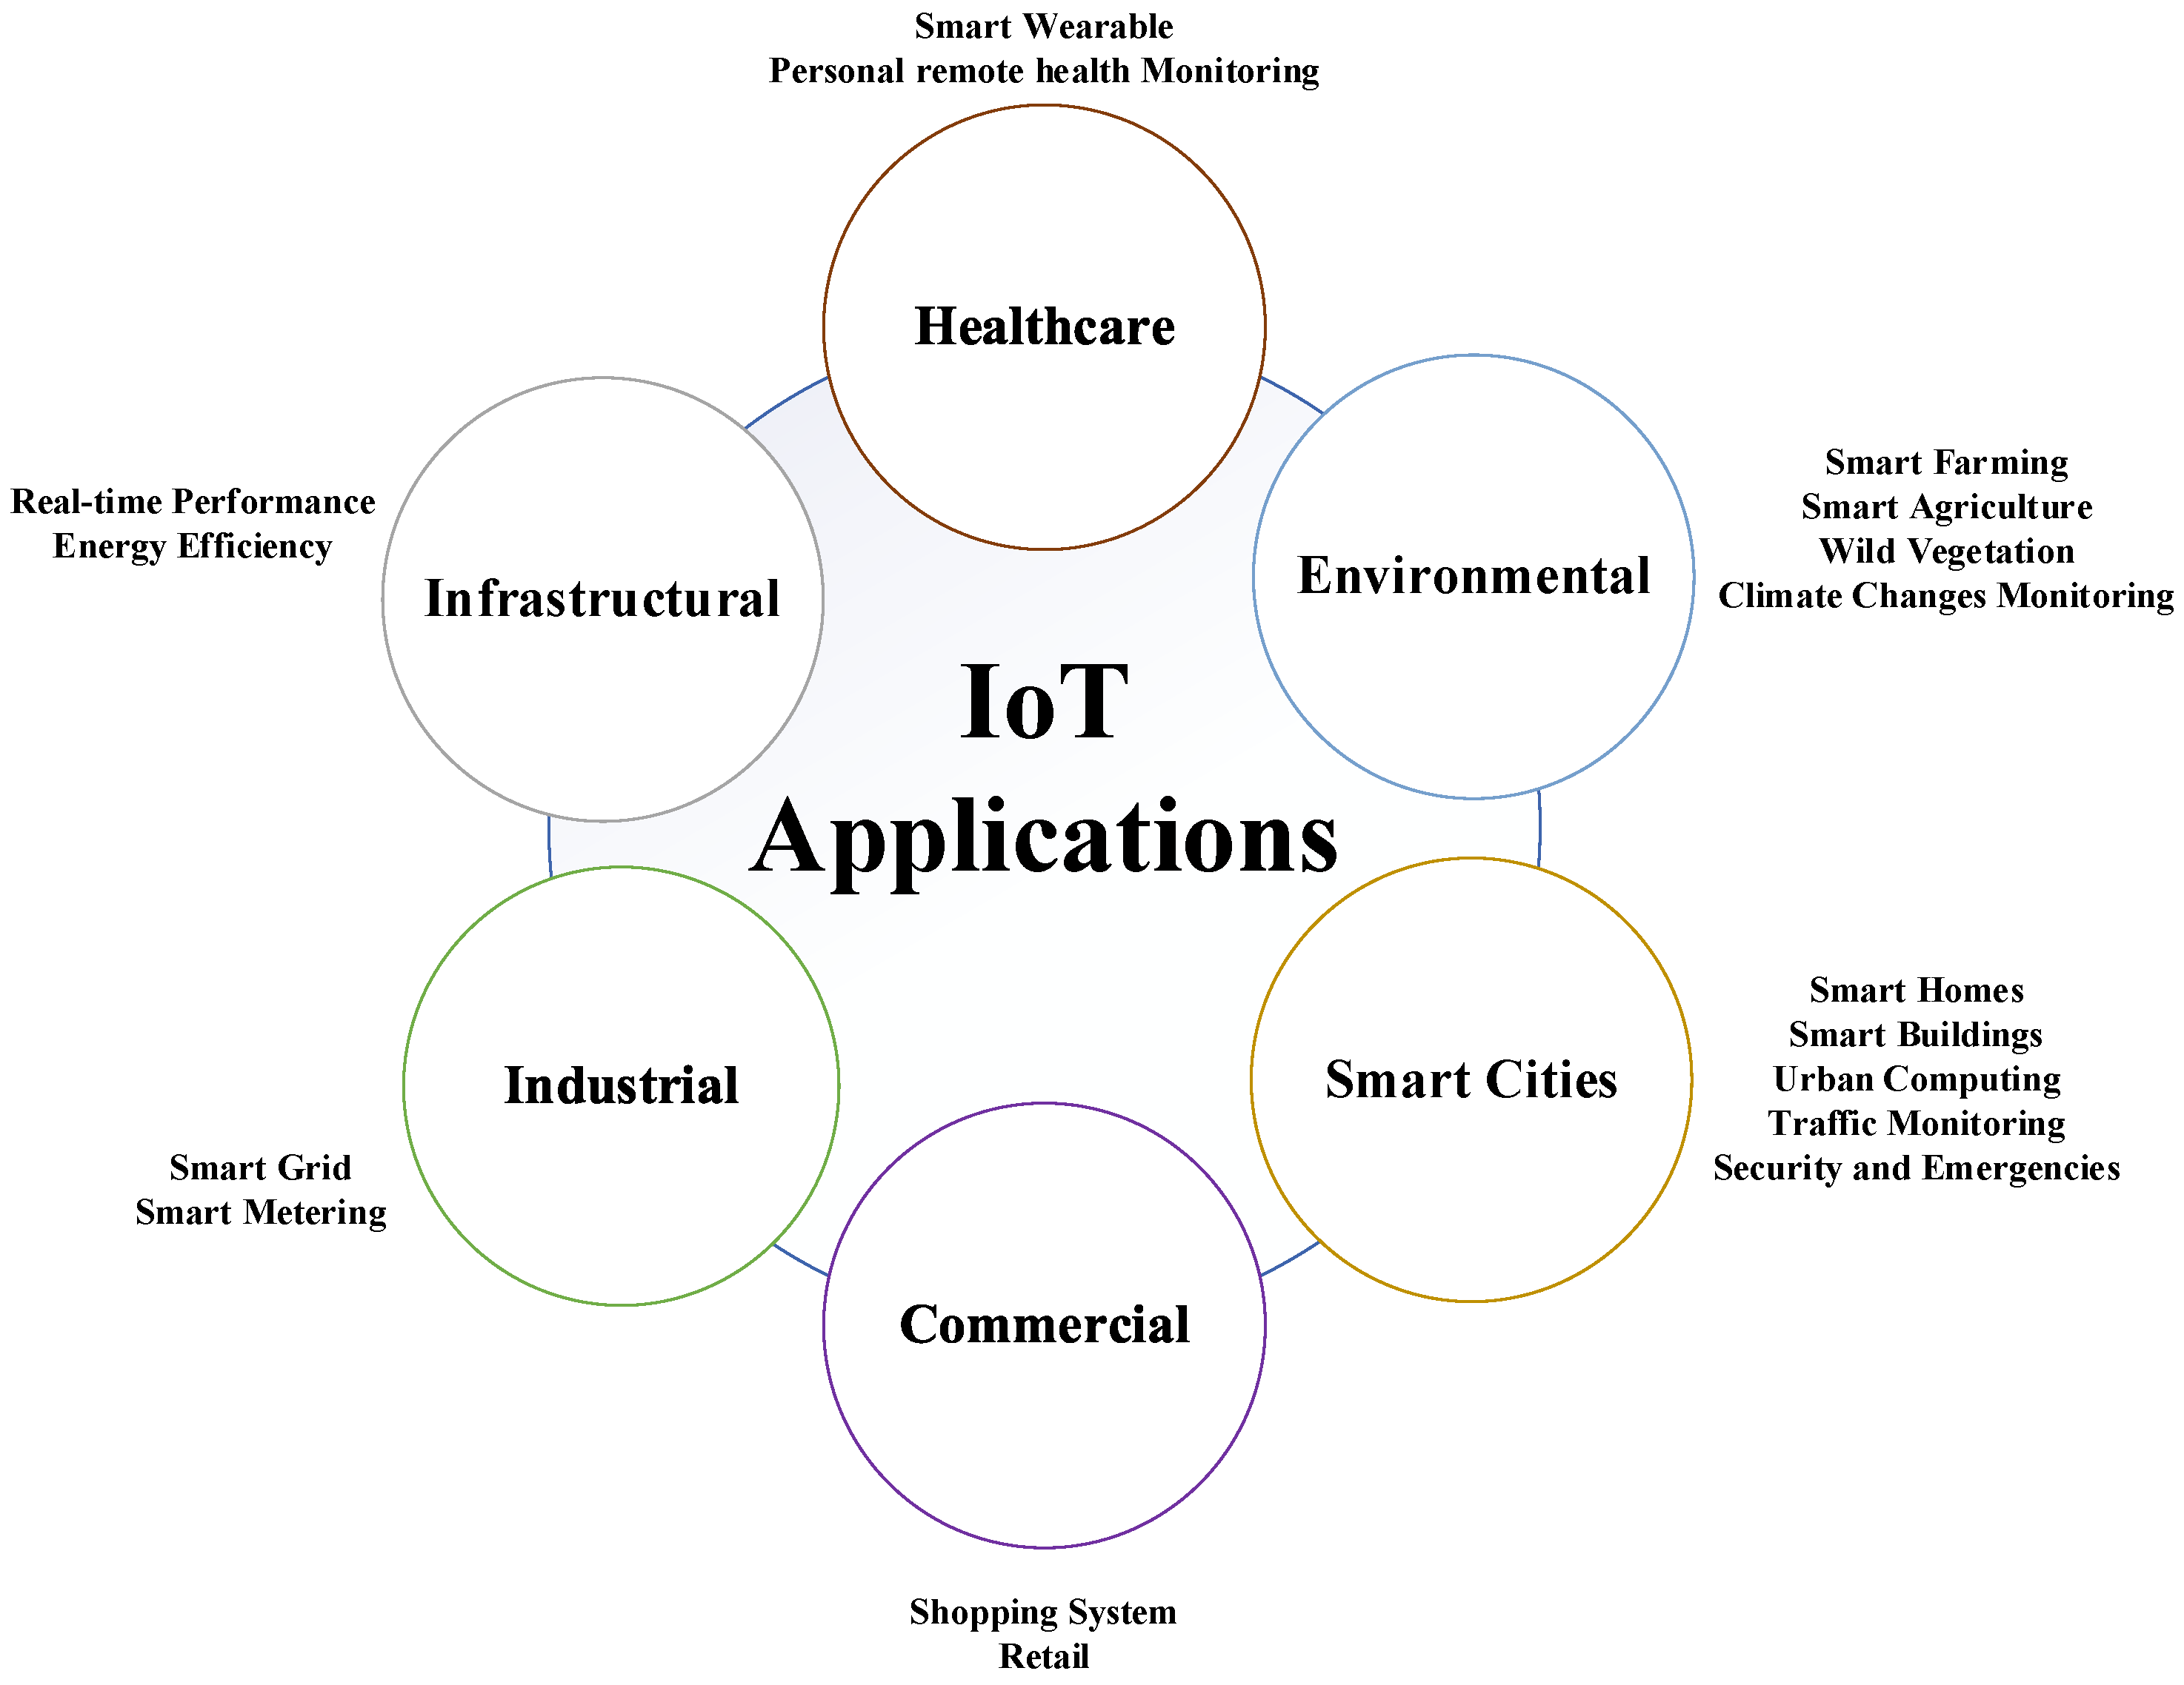
APPLICATIONS OF IOT

Slide 18
APPLICATIONS
Smart Homes - Home Automation, heating and air conditioning, media and security systems, long term saving by ensuring light on/off
Health care – Monitor fall of stroke patient, elderly care applications, voice control devices assist patients with limited movements
Transportation –Integration of communication, control and information processing across transportation system, inter and intra vehicle communication, real time status of vehicles
Fleet management – real time observation of movement and status of cargo , smart parking
Combined with machine learning we can reduce the traffic accidents, and implementation of driver less cars

Slide 19
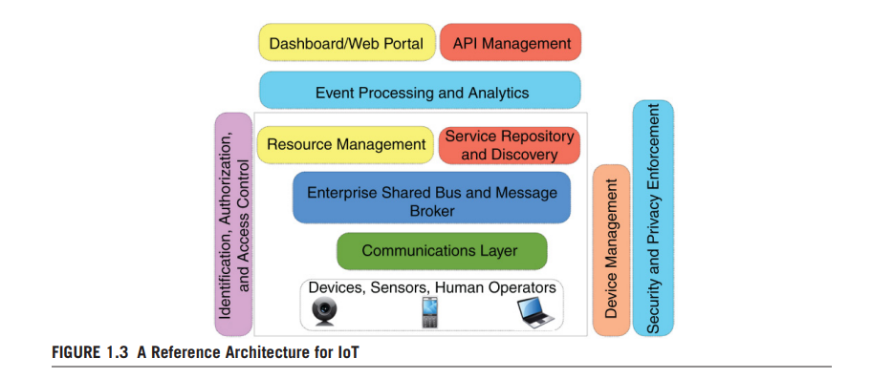
IoT REFERENCE ARCHITECTURES

Slide 20
IoT REFERENCE ARCHITECTURES
Building Blocks of IoT Architectures
Sensory devices, Remote service invocation, Communication networks, and context-aware processing of events
Enterprise shared bus(ESB) services built on the top of communication and physical layer
Service layer include event processing and analytics, resource management and service discovery as well as message aggregation
API management essential for delivering and sharing system services
Web based dash boards for managing and accessing these APIs

Slide 21
IoT SOA ARCHITECTURES
SOA-BASED ARCHITECTURE( service-oriented architecture) ensures the interoperability among the heterogeneous devices
SOA consisting of four layers with distinguished functionalities as follows:
• Sensing layer is integrated with available hardware objects to sense the status of things
• Network layer is the infrastructure to support over wireless or wired connections among things
• Service layer is to create and manage services required by users or applications
• Interfaces layer consists of the interaction methods with users or applications

Slide 22
IoT SOA ARCHITECTURES
Sensing Layer - Sensors and actuators are devices, which help in interacting with the physical environment. The data collected by the sensors has to be stored and processed intelligently in order to derive useful inferences from it
Service layers include event processing and analytics, resource management and service discovery, as well as message aggregation and Enterprise Service Bus (ESB) services built on top of communication and physical layers.
Interface layers - API management, which is essential for defining and sharing system services and web-based dashboards (or equivalent smartphone applications) for managing and accessing these APIs.
Network layer enables the communication

Slide 23
IoT SOA ARCHITECTURES
Advantages:
  A complex system is divided into subsystems that are loosely coupled and can be reused later (modular decomposability feature)
  Ensure that in case of a component failure the rest of the system (components) can still operate normally
  Ensures the interoperability among the heterogeneous devices
  Ensures scalability among the objects in IoT

Slide 24
API-ORIENTED ARCHITECTURE
Conventional approaches for developing service-oriented solutions were use SOAP(Simple Object Access Protocol) and RMI(Remote Method Invocation )
Due to overhead and complexity of these techniques, Web APIs and Representational State Transfer (REST)- based methods were introduced as promising alternative solutions
The resources are triggered by request–response data conversions during service calls that happens regularly
Lightweight data-exchange formats like JSON can reduce the overhead. The smart devices and sensors have a limited amount of resources like network bandwidth, computational and storage capacity
It is easier to enable multitenancy by the security features of modern Web APIs such as OAuth, APIs

Slide 25
IoT : RESOURCE MANAGEMENT
Resource management is challenging for IoT because of the heterogeneous and dynamic nature of resources in IoT
Resource management module needs considerable robustness, fault-tolerance, scalability, energy efficiency, QoS, and SLA.
Three major activates of Resource management are:
Resource Partitioning - involves partitioning the resources to maximize the utility function—which can be in terms of cost, energy, performance, etc.,
Resource/Service Discovery - Resource management involves discovering and identifying all available resources,
Scheduling and Provisioning - It is the task of scheduling the task on available physical resources

Slide 26
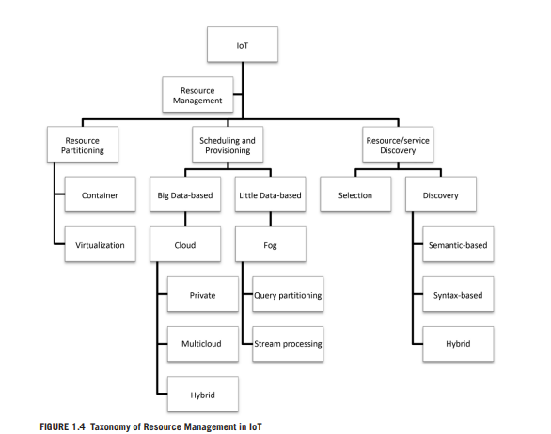
TAXONOMY OF RESOURCE MANAGEMNT(pg.36)

Slide 27
1.RESOURCE PARTITIONING
It is to efficiently partition the resources and gain a higher utilization rate
The idea of resource partitioning is used in cloud computing via virtualization techniques and commodity infrastructures
VMs, requires a considerable amount of memory and computational capacity, this configuration is not suitable for IoT
The concept of Containers can match the demand of devices with limited resources. Docker and Rocket are the two most famous container solutions.

Slide 28
RESOURCE PARTITIONING
CONTAINERS
Containers provide portable and platform-independent environments for hosting the applications and all their dependencies, configurations, and input/output settings
Containers are lightweight virtualization solutions that enable infrastructure providers to efficiently utilize their hardware resources by eliminating the need for purchasing expensive hardware and virtualization software packages
Containers are ideal for distributed applications in IoT that need to scale up within a short amount of time

Slide 29
RESOURCE PARTITIONING
COMPUTATION OFFLOADING
Code offloading (computation offloading) is a solution for addressing the limitation of available resources in mobile and smart devices.
The advantages of using code offloading provide more efficient power management, fewer storage requirements, and higher application performance.
Code offloading techniques require the developers to manually annotate the functions required to execute on another device
Virtual machines offered by IaaS cloud providers as offloading, this targets to boost both scalability and elasticity.
The combination of VMs and mobile clouds can create a powerful environment for sharing, synchronizing, and executing codes in different platforms.

Slide 30
2.IDENTIFICATION AND RESOURCE/SERVICE DISCOVERY
The objective is to identify and locate the actual device, which can be achieved by storing and indexing metadata information about each object.
The final step is to discover the target service that needs to be invoked.
Lack of an effective discovery algorithm can result in execution delays, poor user experience, and runtime failures.
Efficient algorithms can minimize the consumed energy and other factors like mobility and latency to offer a suitable solution for IoT.

Slide 31
3. RESOURCE SCHEDULING AND PROVISIONING
Approaches used Fog-computing and Cloud Computing
In the context of fog computing, available resources like network bandwidth and computational and storage-capacity are converted to time resources(The length of time a resource is required for a specific project.).
Fog-computing is forming a framework that facilitates resource sharing.
Depending on Big Data or Little Data the resources in Cloud or Fog is selected
The main activities done in the fog are query partitioning and stream processing

Slide 32
IoT DATA MANAGEMENT AND ANALYTICS

Slide 33
IoT DATA MANAGEMENT AND ANALYTICS
The challenge in IoT is to manage and analyze huge amount of data originating from, and circulating in, from a distributed and heterogeneous environment.
Big Data is characterized by 3Vs, namely velocity, volume, and variety
These three Big Data dimensions has led to the introduction of different data-processing approaches.
Big Data related procedures, such as data acquisition, filtering, transmission, and analysis have to be updated to match the requirements of the IoT data deluge
Batch Processing and Stream Processing are two major methods used for data analysis

Slide 34
IoT DATA MANAGEMENT AND ANALYTICS
IoT AND THE CLOUD
Cloud computing provides on-demand processing and storage capabilities.
It can be used to analyze data generated by IoT objects in batch or stream format.
A pay-as-you-go model adopted by all cloud providers
Which has reduced the price of computing, data storage, and data analysis.
With cloud’s elasticity and distributed processing engines, can implement important features such as fault-tolerance and autoscaling for bursty workloads

Slide 35
IoT DATA MANAGEMENT AND ANALYTICS
REAL-TIME ANALYTICS IN IoT AND FOG COMPUTING
Processing data generated from millions of sensors and devices in real time is more challenging
Cloud computing cannot address the latency constraints of real-time applications
Real-time processing requirements and the increase in computational power of edge devices such as routers, switches, and access points lead to the emergence of the Edge Computing paradigm
The Edge layer contains smartphones, smart TVs, network routers, and so forth, and they are closer to the user
Processing and storage capability of these devices can be utilized by creating another cloud, known as Edge Cloud
This will decrease network delay, save processing or storage cost, perform data aggregation, and prevent sensitive data from leaving the local network

Slide 36
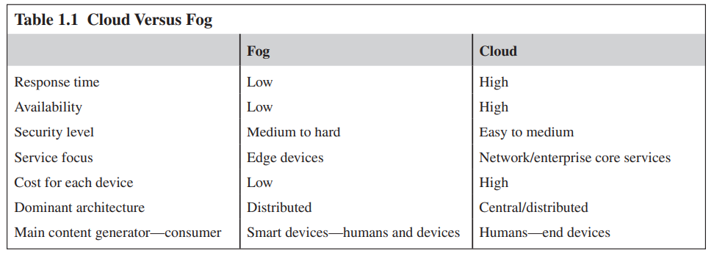
CLOUD Vs FOG

Slide 37
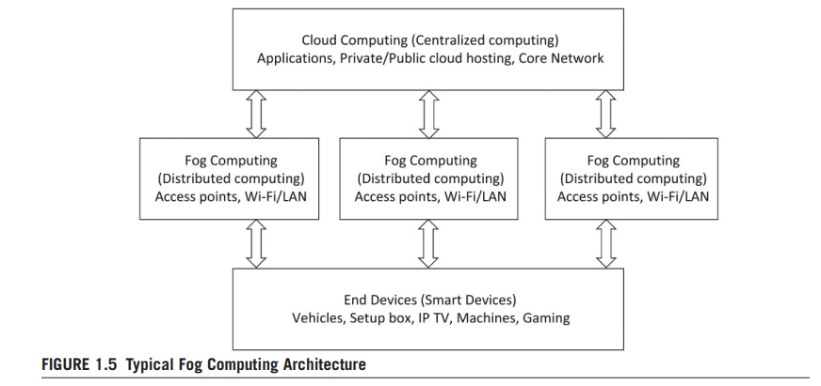
TYPICAL FOG ARCHITECTURE

